Slide 1
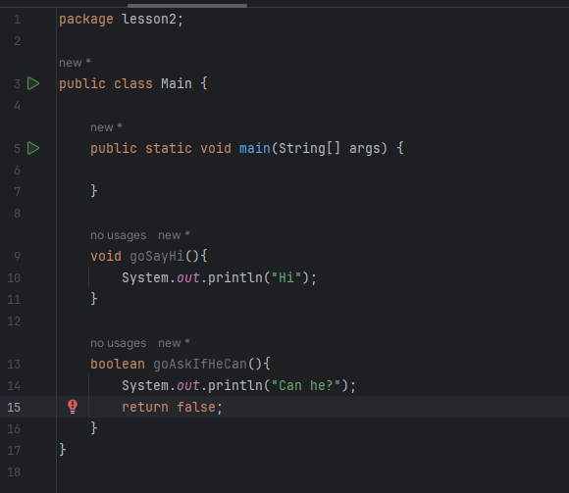
Some questions

Slide 2
What we have learned so far
Convention:
Paket adlari kicikle yazilir
Class adlari hemise boyukle yazilir
Method adlari kicikle baslayir ve CamelCase kimi davam edir
Eyni method adini iki defe istifade etmirik (overloading-den basqa)*
Commentler iki cur olur : // /* */
Class adi
Main method
Hecne dondurmeyen parametrsiz method
Boolean donduren parametirsiz method

Slide 3

Java Basics :
Operators
Scanner – input
If-else
Creating object
Local variables vs instance and class.

Slide 4
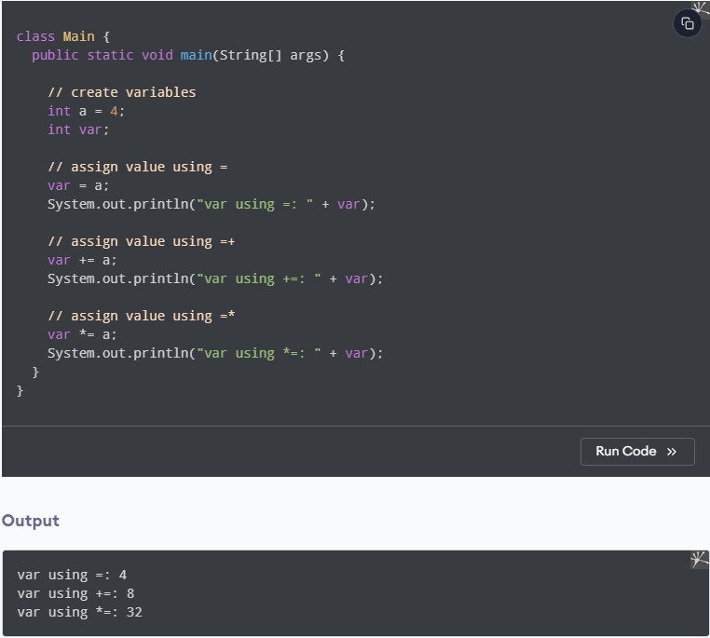
Operators :
+ - / % *
+= -= /= *= %=
== != > < >= <=
&& || !
++ -- (post and pre)

Slide 5
Scanner :
Input values
Write simple project

Slide 6
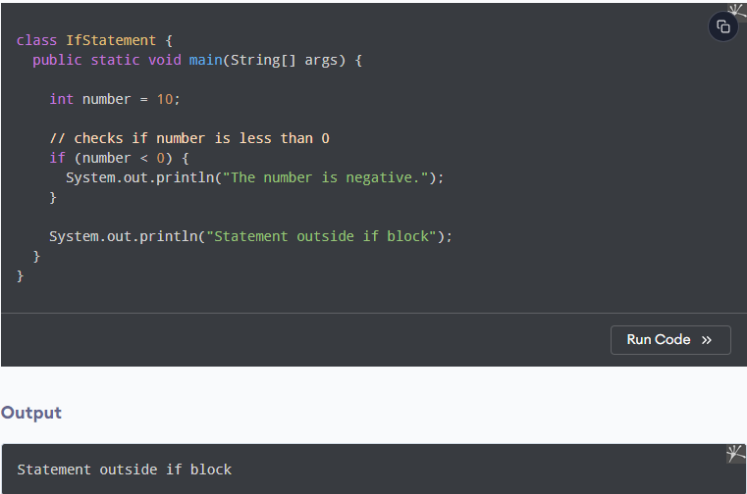
If-else :
Control flow

Slide 7
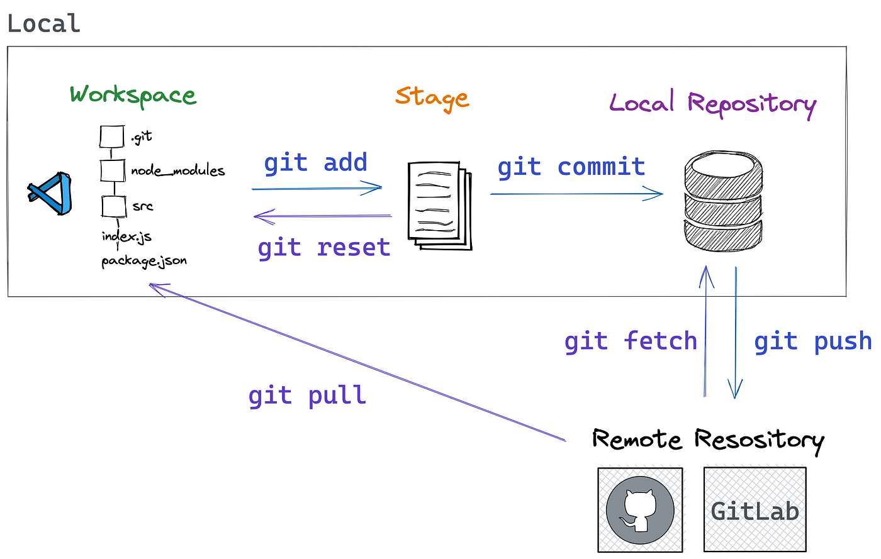
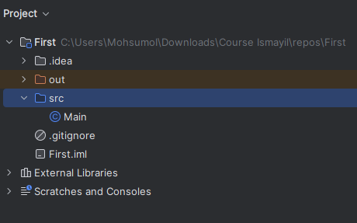

Let’s practice:
Create PR with simple tasks

